Slide 1
Assignment:19MAT105 MATHEMATICS FOR INTELLIGENT SYSTEMS
SUBMITTED BY GROUP 19
Names of Group members :
1.VIGNESH M. [1008496 ]
2.VIKHYAT BANSAL [1007359]
3. YARRAM SRI SATHWIK REDDY [1038833]
4.AMAN SIROHI [1042496]

Slide 2

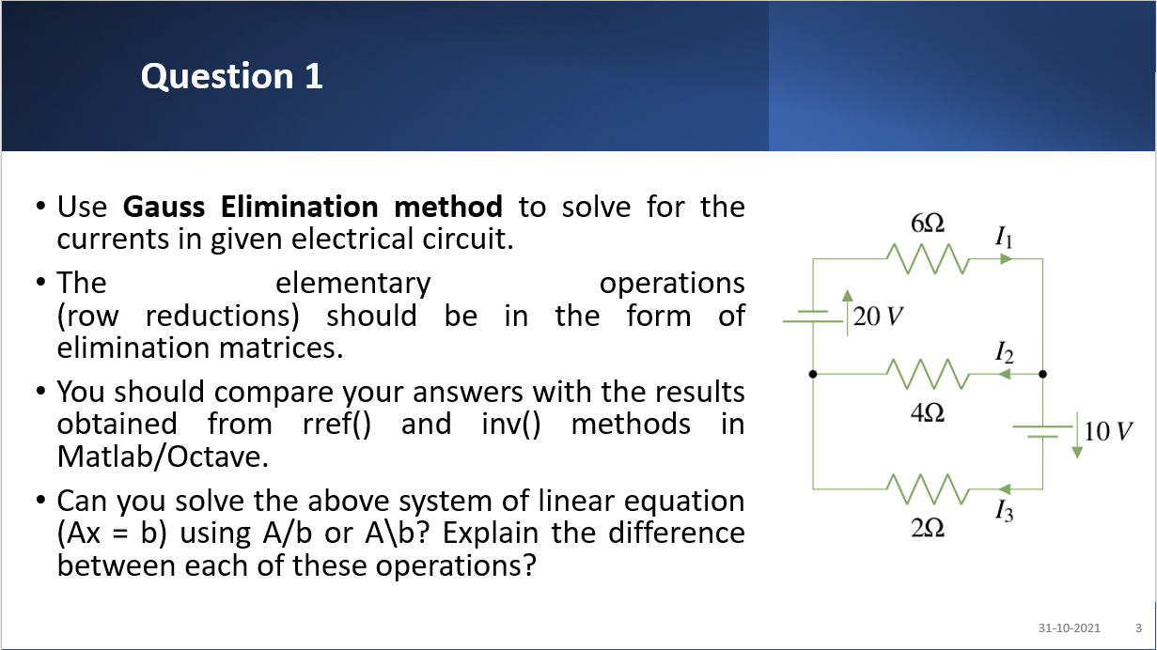

Slide 3
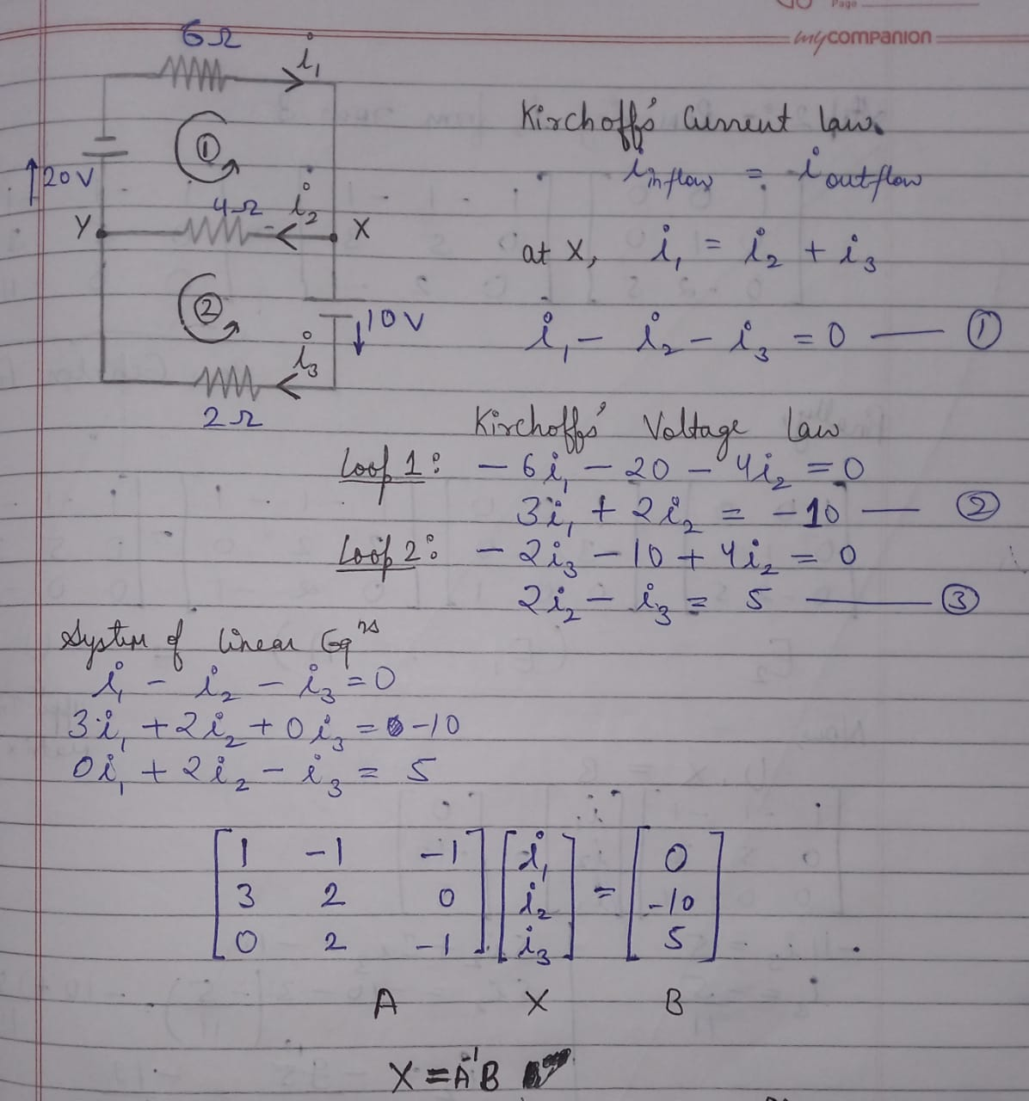
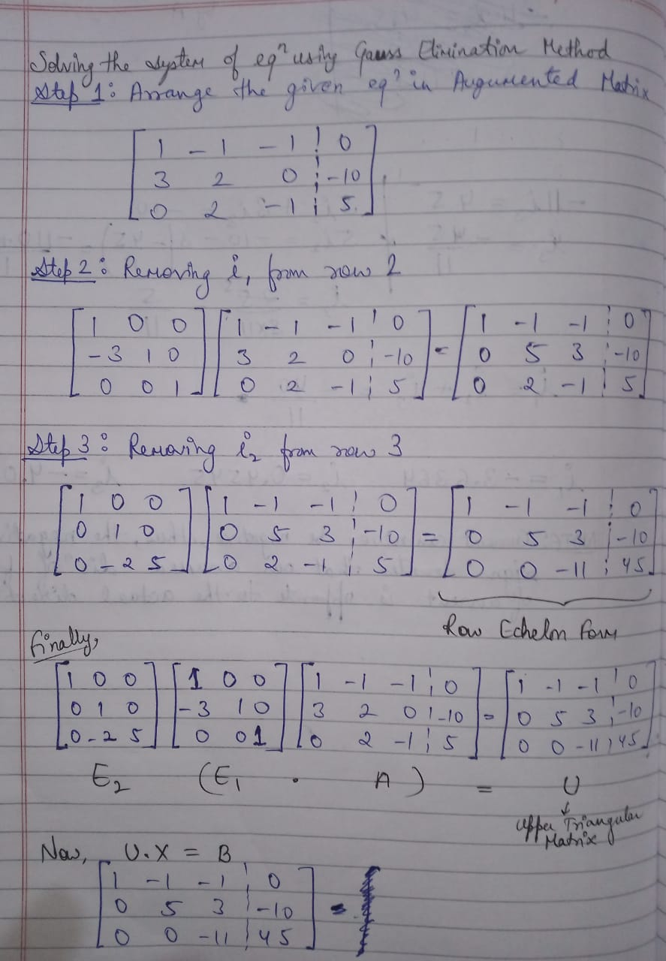

Slide 4
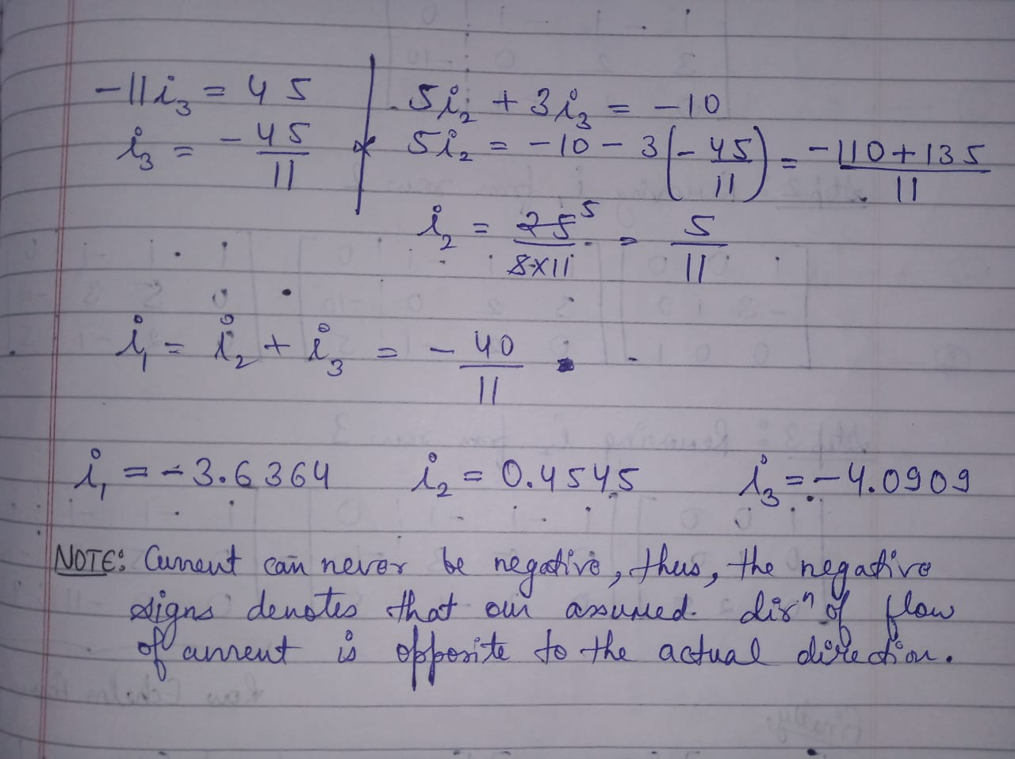

Slide 5

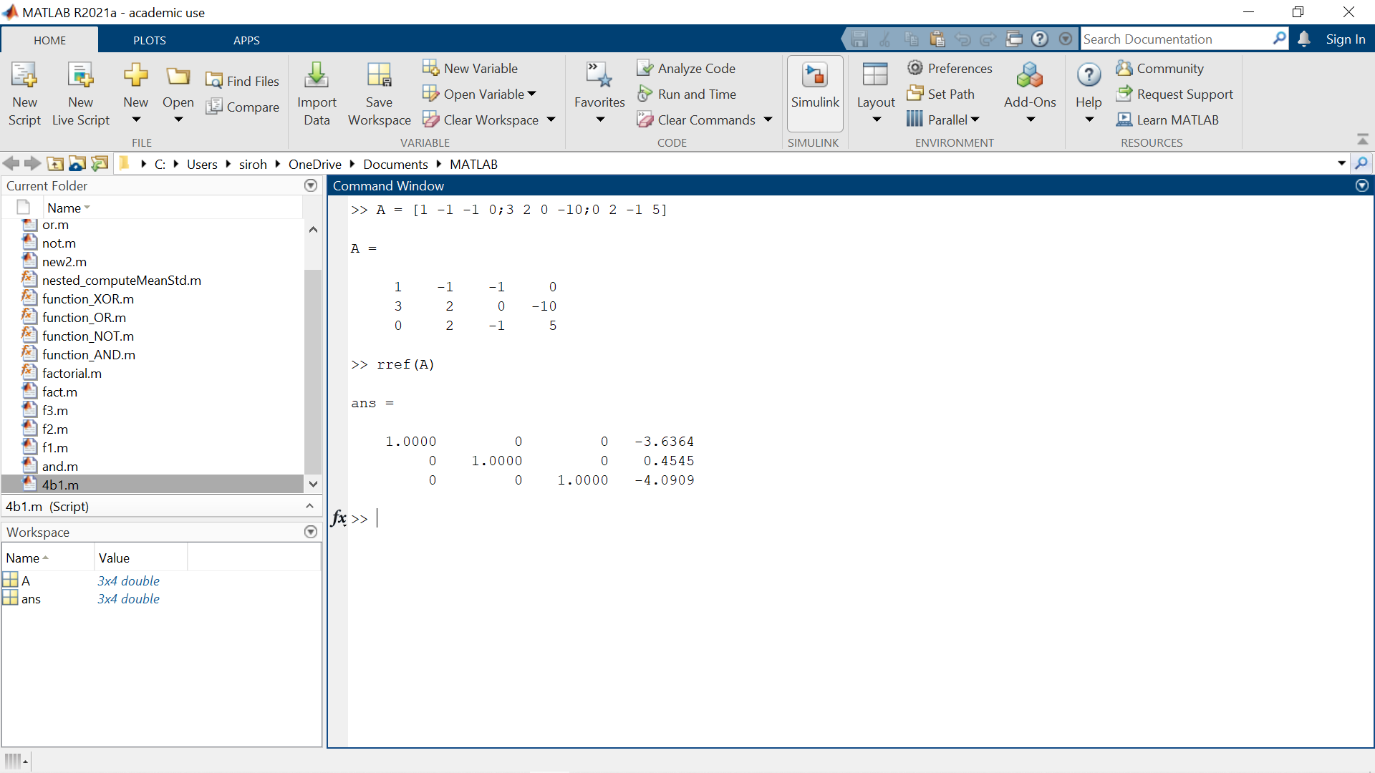
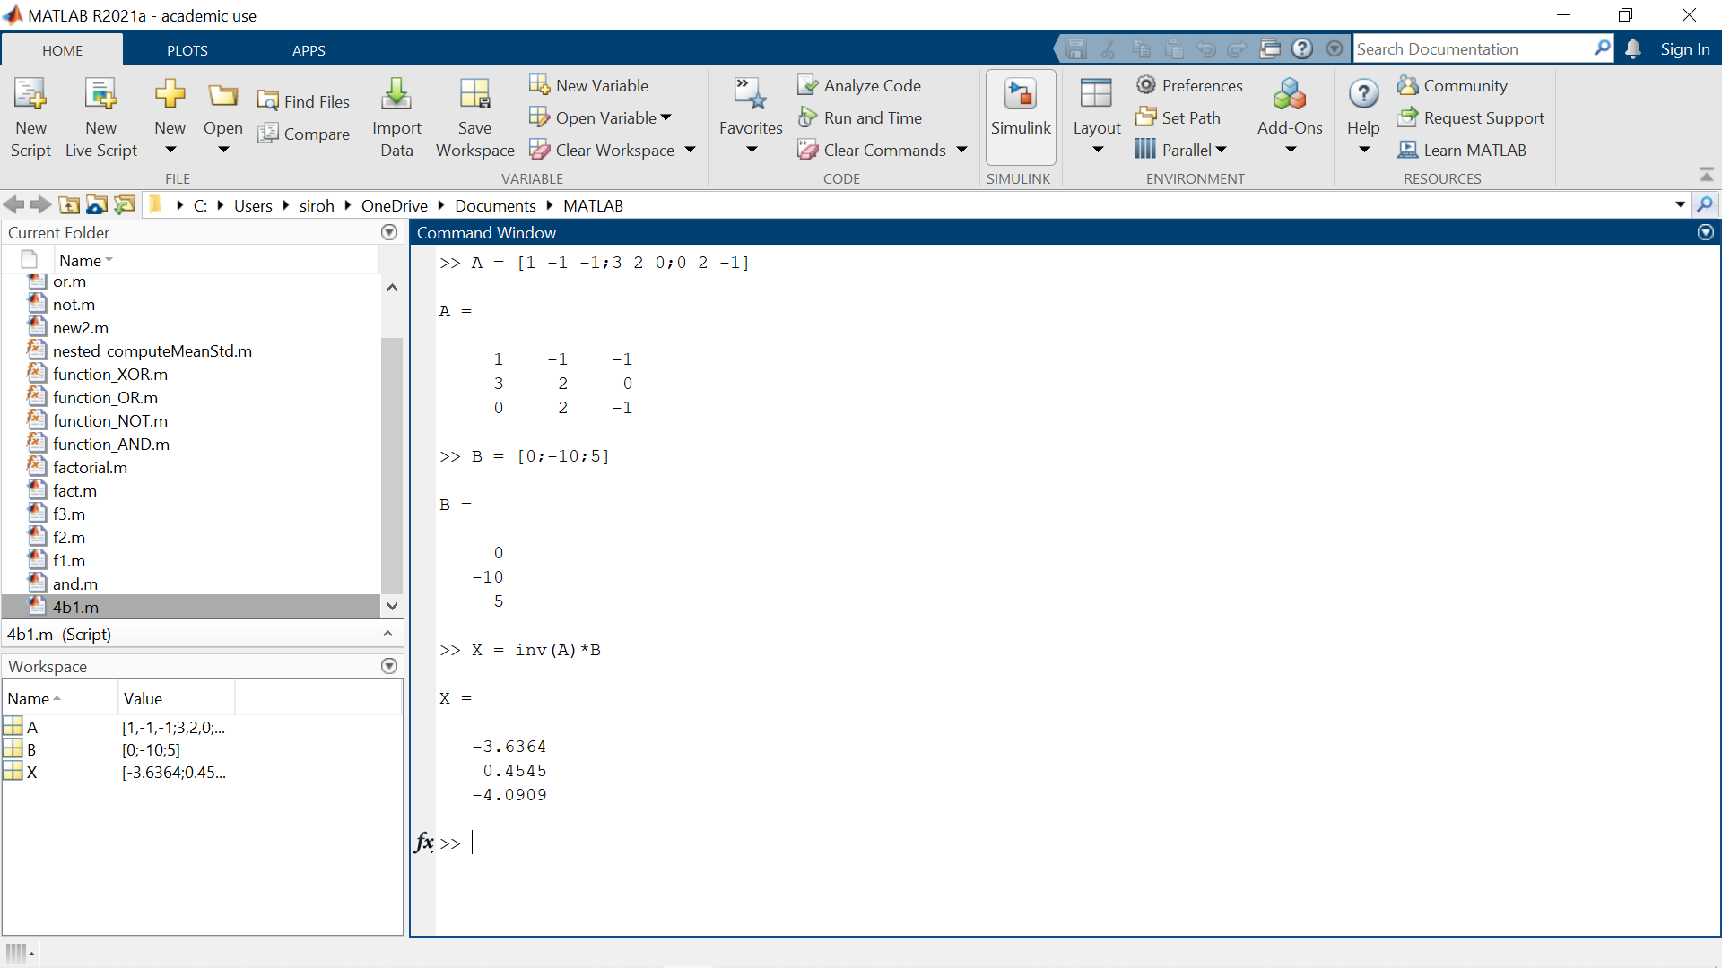
Inv() :- Inverse of the Matrix
rref() :- Reduced Row Echelon Form

Slide 6
Can you solve the above system of linear equation (Ax = b) using A/b or A\b? Explain the difference between each of these operations?
Ans: Yes, we can use A\B but not A/B.
The backslash operator (\) is used to solve a linear equation of the form a*x = b, where ‘a’ and ‘b’ are matrices and ‘x’ is a vector.
It is used to calculate the left division between two matrices.
It can be used as alternative for inv(A)*B
For backslash operator to work, both the input matrices must have an equal number of rows.
Whereas forward slash operator (/) is used to calculate right division between two matrices.
It can be used as alternative for A*inv(B)
For forward slash also, the matrices must have equal number of columns.

Slide 7
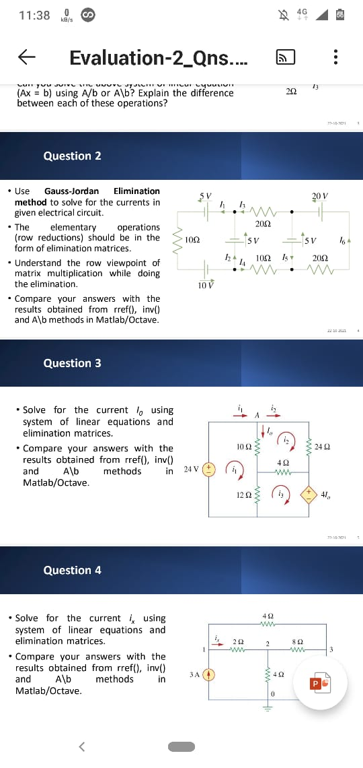
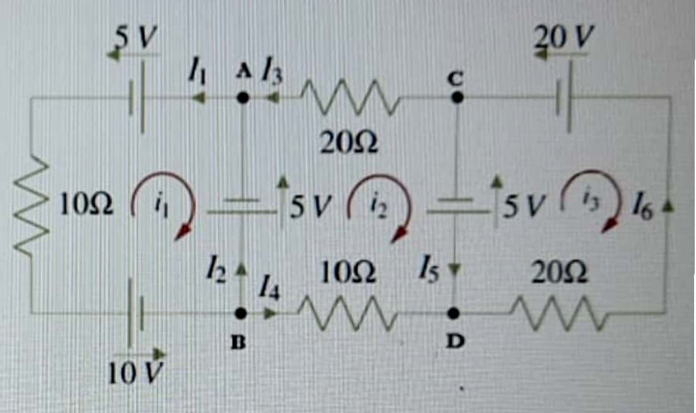
2) Question:
Using mesh analysis :
Now assume i₁,i₂,i₃ as the mesh currents
Apply KVL for mesh 1:
*KVL(Sum of the voltage difference around any closed loop in
a circuit must be zero)
-10i₁ + 5v +5v +10v = 0
10i₁ + 0i₂ + 0i₃ = 20v ------(1)

Slide 8
Apply KVL for Mesh 2:
-10i₂ - 5v –20i₂ +5v = 0
0i₁ + 30i₂ + 0i₃ = 0v ---------(2)
Apply KVL for Mesh 3:
-20i₃ – 5v +20v =0
0i₁ +0i₂ +20i₃ =15v -----------(3)
Apply KCL at nodes A,B,C,D
*KCL (Summation of current entering at
Node = Summation of the current leaving
the node)
# At 'A' I₁ = I₂ + I₃ # I₅ = I₆ ; # I₃ = I₄
# At 'c' I₃ = I₆ – I₅ # At 'B' I₂ = i₂ - i₁
# At 'D'I₄ = I₆ – I₅ # I₅ = i₂ - i₃

Slide 9
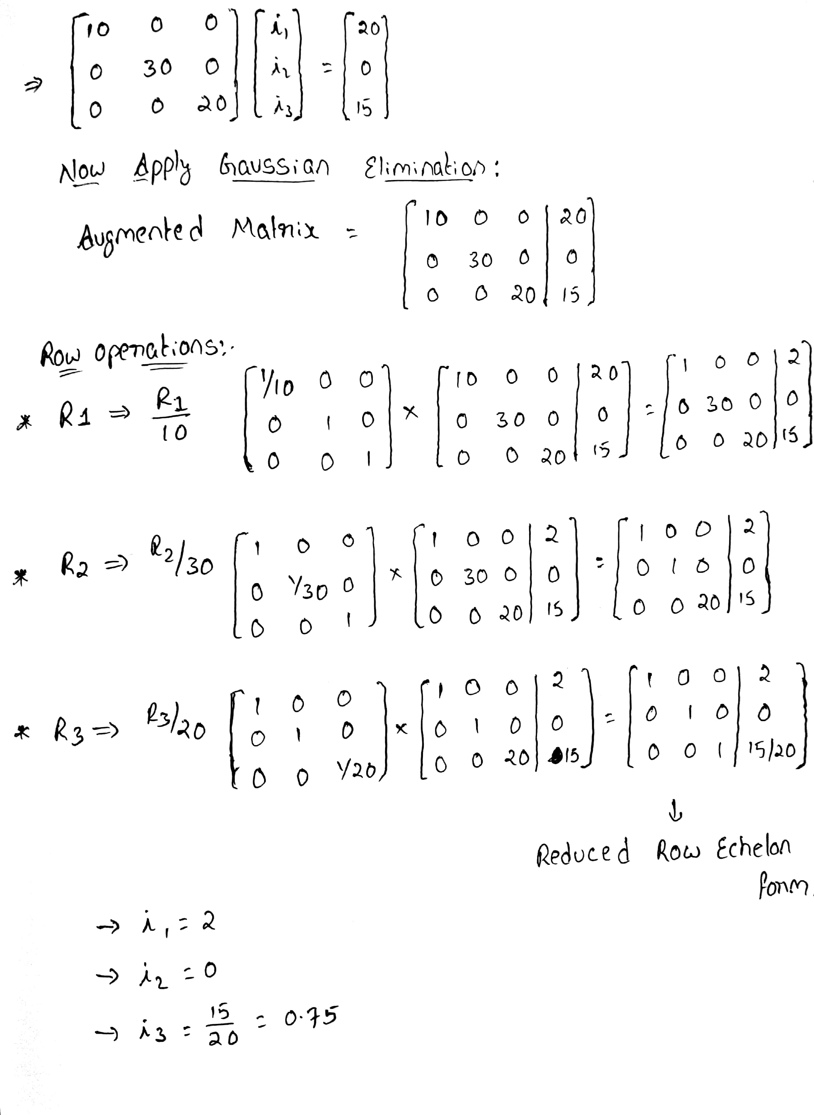
Consider the linear equations :
10i₁ + 0i₂ + 0i₃ = 20v -----(1)
0i₁ +30i₂ + 0i₃ = 0v -----(2)
0i₁ + 0i₂ +20i₃ = 15v -------(3)
Mesh Network Matrix:

Slide 10
*I₂ = i₂ – i1 * i1 = 2
* i₂ = 0
*I₂ = 0 –2 = -2 * i₃ = 0.75
*I₅ = i₂ –i₃
*I₅ = 0 – 0.75 = -0.75
; I₅ = I₆ = -0.75 *By Applying KCL at nodes A,B,C,D we are
Getting i₁,i₂,i₃,i₄,i₅,i₆
*I₃ = I₆ – I₅ = 0
; I₃ = I₄ = 0
* I₁ = I₂ + I₃
*I₁ = -2 + 0 = -2

Slide 11
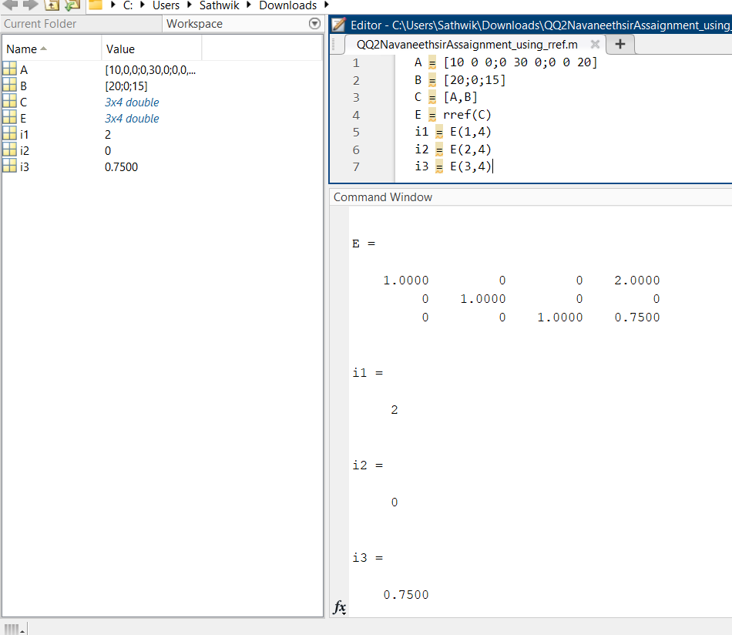
Comparing i₁,i₂,i₃ values using
* rref()
*inv()
*A\B
*rref() Method using Matlab:
*rref code is
used to form
reduced row
echelon form of
symbolic matrix
* i₁ = 2
* i₂ = 0
* i₃ =0.75

Slide 12
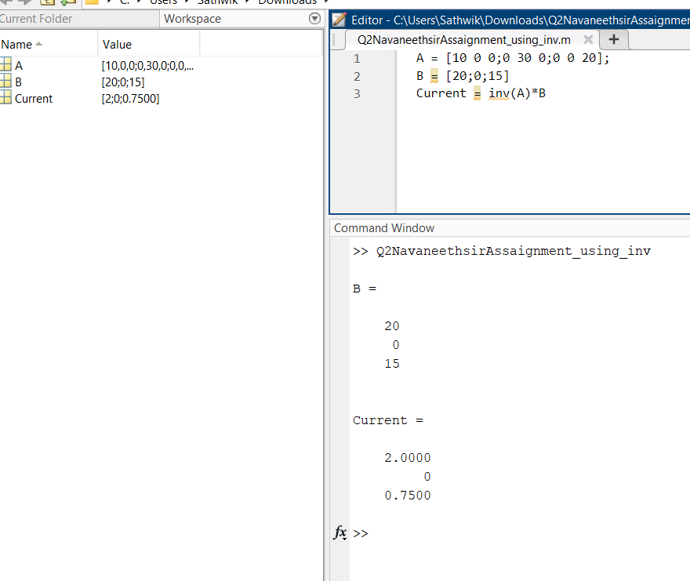
By using inv() method:
*i₁ = 2
*i₂ = 0
*I₃ = 0.75

Slide 13

*By using A\B method:
*i₁ = 2
*i₂ = 0
*i₃ = 0.75
*Hence the results are obtained from rref(),inv() and A\B methods in Matlab are Same answer with different codes and matrices having different rows and columns .

Slide 14
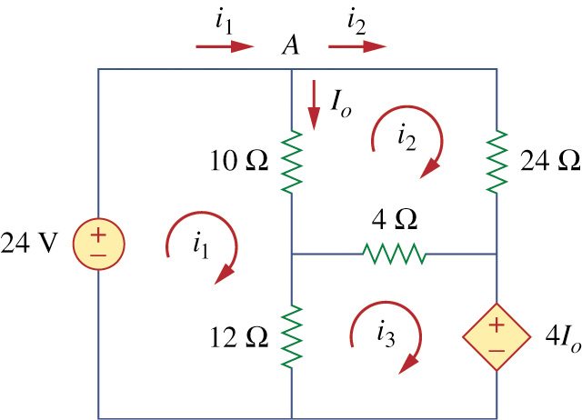
QUESTION 3.1)
• Solve for the current I₀ using system of linear equations and elimination matrices
By using KIRCHHOFF'S VOLTAGE LAW ,
In Mesh I ,
-24 + 10( i₁ – i₂ ) +12(i₁ – i₃ ) = 0
22i₁ – 10i₂ – 12i₃ = 24
11i₁ – 5i₂ – 6i₃ = 12 (1)
In Mesh II ,
24i₂ + 4(i₂ – i₃ ) +10( i₂ – i₁ ) = 0
– 10i₁ + 38i₂ – 4i₃ = 0
– 5i₁+ 19 i₂ – 2i₃ = 0 (2)
In Mesh III ,
4I₀ + 12( i₃ – i₁ ) + 4(i₃ – i₂) = 0
4(i₁ – i₂)+ 12( i₃ – i₁ ) + 4(i₃ – i₂) = 0 { i₀ = i₁– i₂ }
– i₁ – i₂ + 2i₃ =0 (3)

Slide 15

Solve the equations 1,2
11i₁ – 5i₂ – 6i₃ = 12 (1)
(+) – 11i₁ – 11i₂ – 22i₃ = 0 (3)×11
------------------------------
– 16i₂ – 16i₃ = 12 – 4i₂ + 4i₃ = 3 (4)
------------------------------
Solve the equations 3,2
– 5i₁ – 5i₂ + 10i₃ = 0 (3)×5
(–) – 5i₁ + 19i₂ – 2i₃ = 0 (2)
------------------------------
– 24i₂ + 12i₃ = 0 – 2i₂ + i₃ = 0 (5)
------------------------------
Solve the equations 4,5
– 8i₂ + 4i₃ = 0 (5)×4
(–) – 4i₂ + 4i₃ = 3 (4)
---------------------
– 4i₂ = – 3 i₂ = ¾ = 0.75 A
---------------------
From (5) – 2(0.75) + i₃ = 0 i₃ = 1.5 A
From (3) – i₁ – 0.75 + 2(1.5) = 0 i₁ = 2.25 A

Slide 16
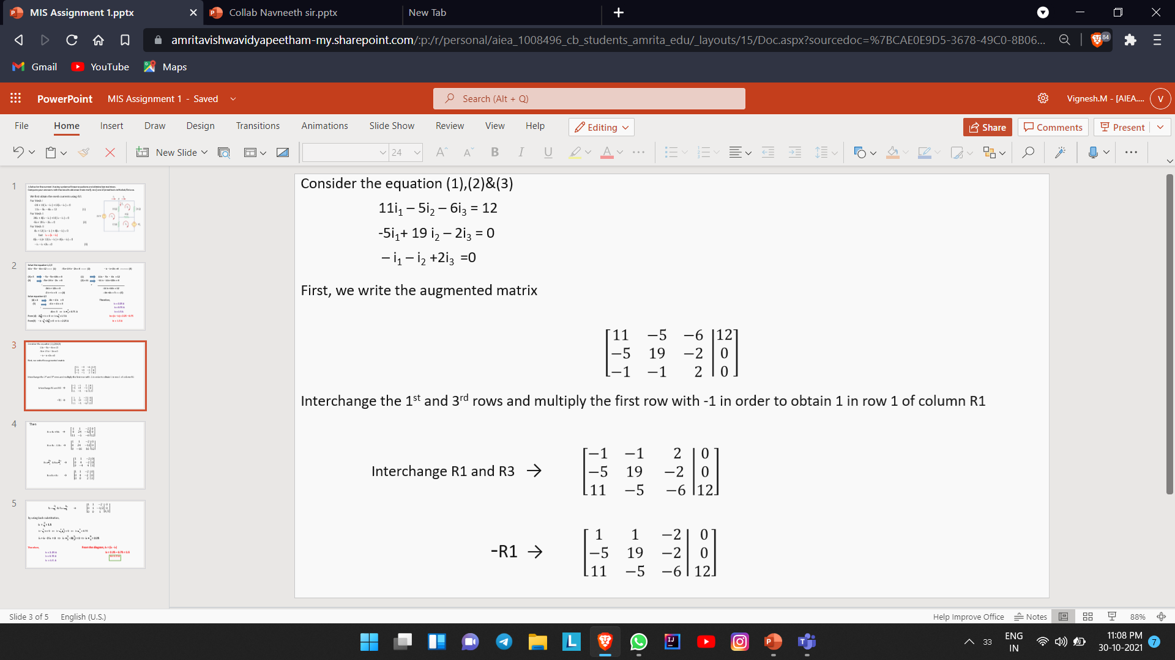
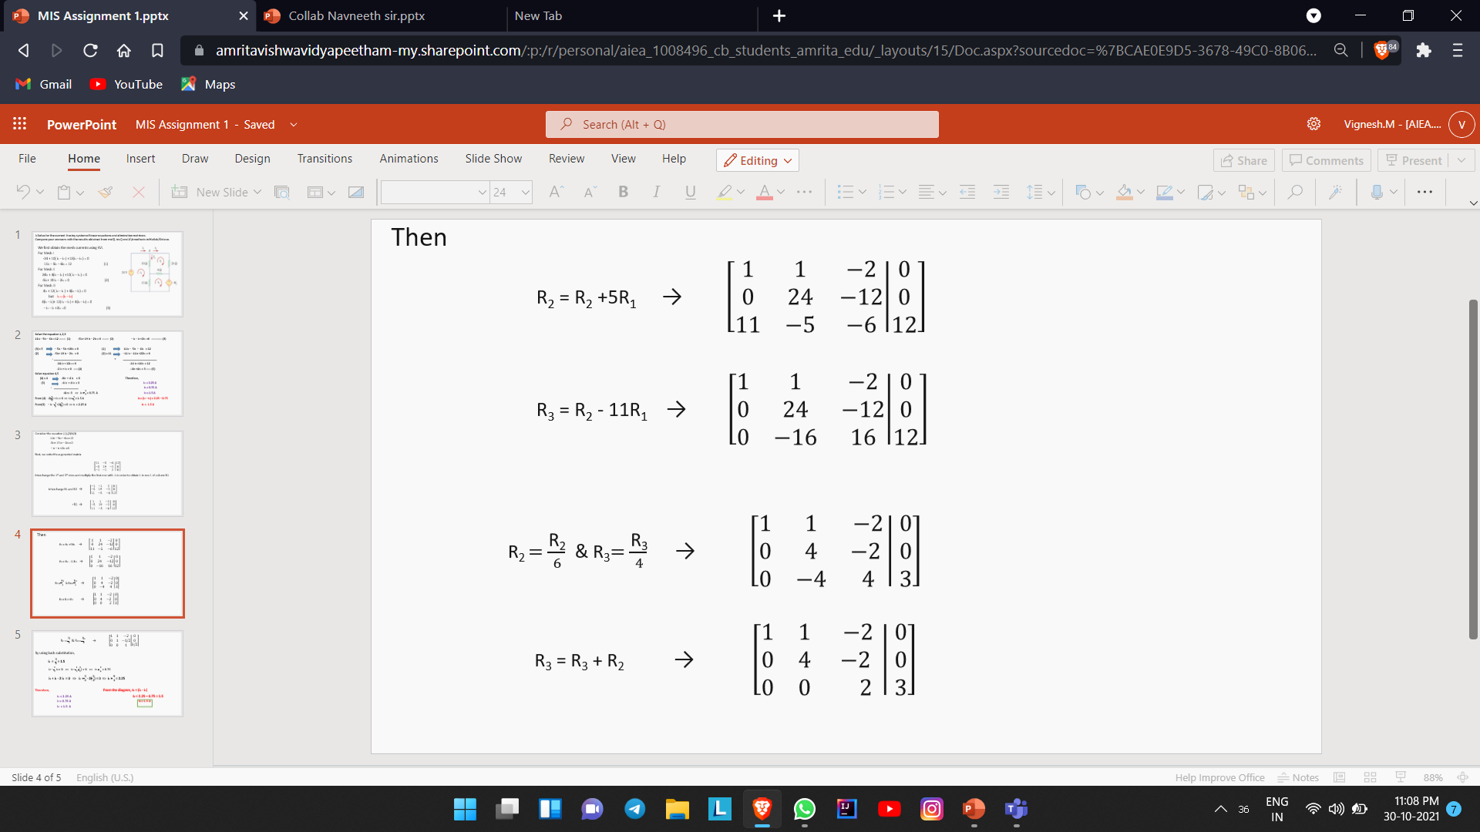
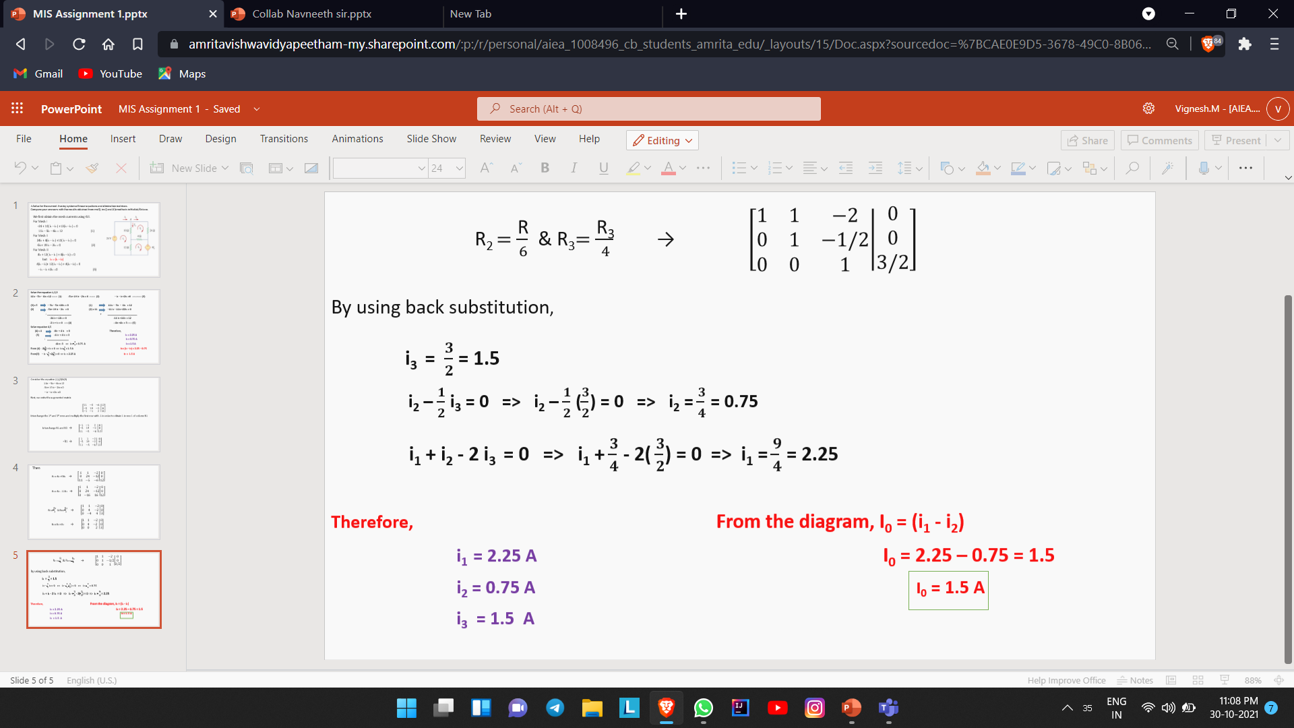
Therefore,
i₁=2.25 A, i₂ = 0.75 A, i₃ = 1.5 A, i₀ = (i₁ - i₂) = 1.5 A
Now let's get into ELIMINATION OF MATRIX,
Consider those linear equations, 11i₁ – 5i₂ – 6i₃ = 12 (1)
– 5i₁+ 19 i₂ – 2i₃ = 0 (2)
– i₁ – i₂ + 2i₃ = 0 (3)
Here the augmented matrix is
R1 R3 and R1= - R1
R2 = R2 + 5R1
R3 = R3 – 11 R1
R3 = R3/2 and R2 = R2/4
R3 = R3 + R2
R2 = R2/6 and R3 = R3/4

Slide 17

Then by substitution,
i₃ = 3/2 = 1.5 A
i₂ – ½ i₃ = 0 i₂ – ½ (3/2) = 0 i₂ = ¾ = 0.75 A
I₁ + i₂ – 2i₃ = 0 i₁ = 9/4 = 2.25 A
I₀ = i₁ – i₂ = 2.25 A – 0.75 A = 1.50 A
Therefore,
I₀ = 1.5 A , i₁ = 2.25 A , i₂ = 0.75 A , i₃ = 1.5 A
QUESTION 3.2)
•Compare your answers with the results obtained from rref(), inv() and A\b methods in Matlab/Octave

Slide 18
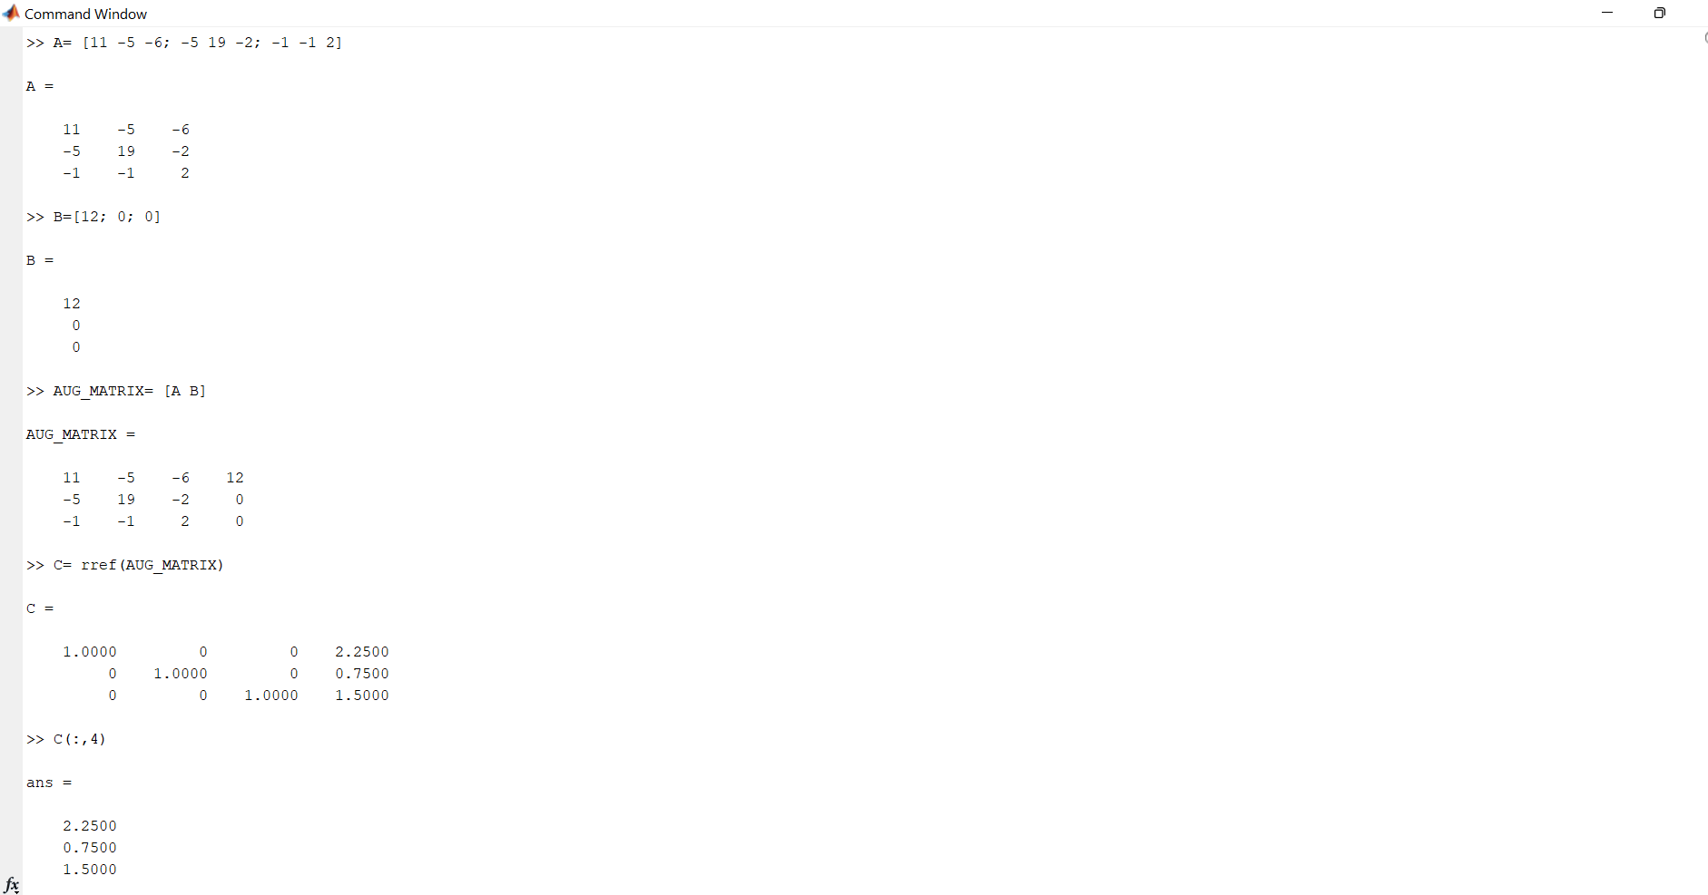

Slide 19
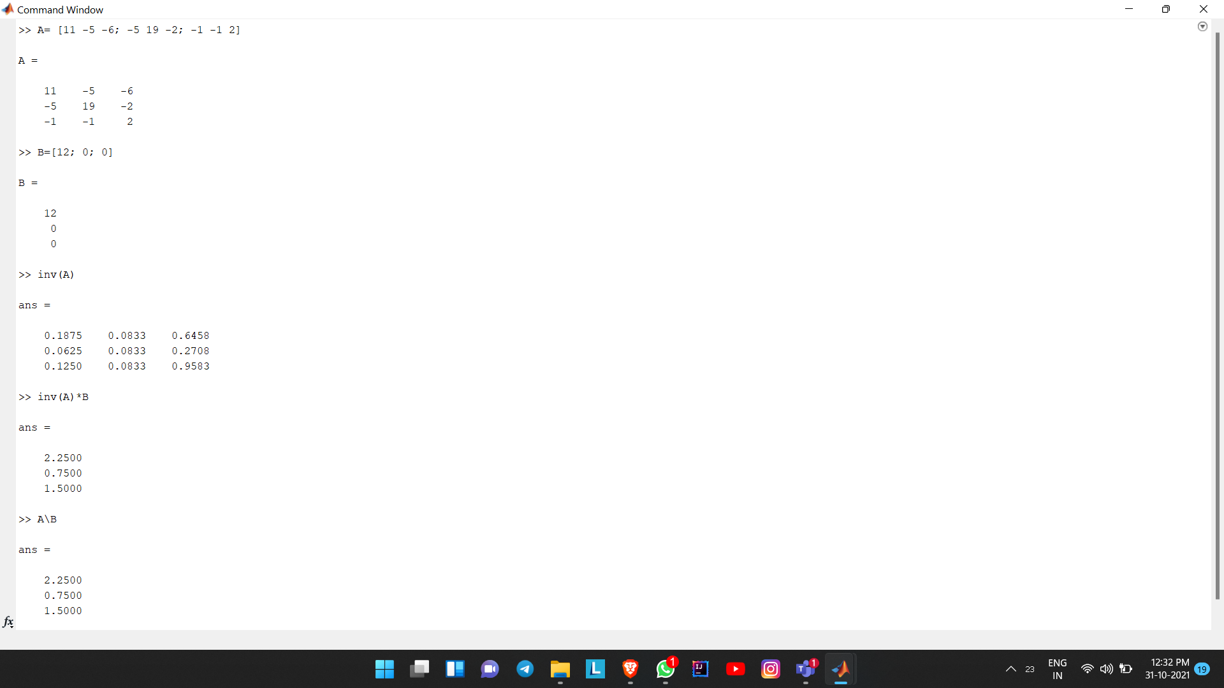

Slide 20
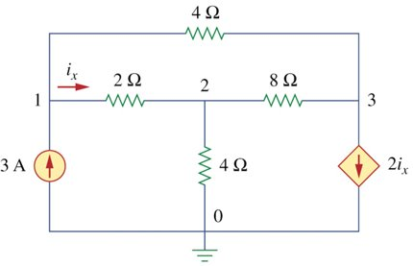
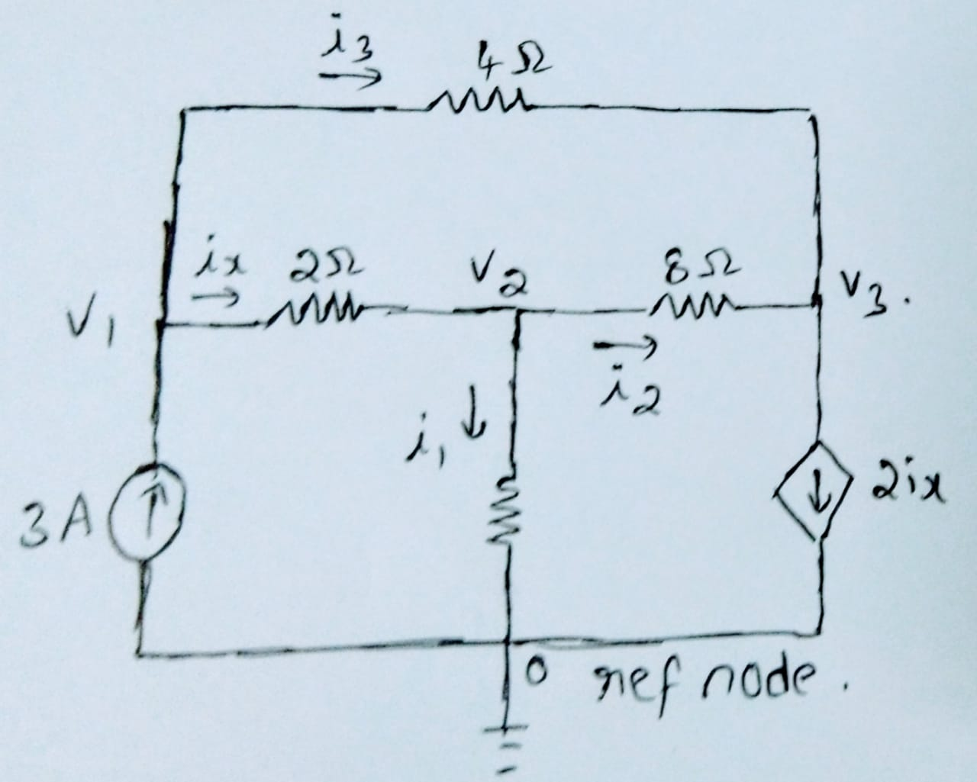



Question 4
Solve for the current i_{x} using system of linear equations.
Solving using linear equations:- Firstly let us write equations for given circuit using mesh analysis
Loop1
As current source is already given in diagram the current in loop1 will be nothing but 3A.
i₁ = 3A
Loop2
Again as can be seen from diagram current source is given but here current from current source is unknown which here we need to find.
i₂ = 2i_{x}
Loop3
Now in loop3 as no current source is present we need to write an equation using mesh analysis which is based on one of the Kirchoff’s Law.
Equation is
-4i₃-8(i₃-i₂)-2(i₃-i₁) = 0
Which on further solving gives,
+2i₁+8i₂-14i₃ = 0
From loop1 and loop3 relation of i_{x} with flowing current can be shown,
-i_{x} = -i₁+i₃ i_{x} = i₁-i₃

Slide 21
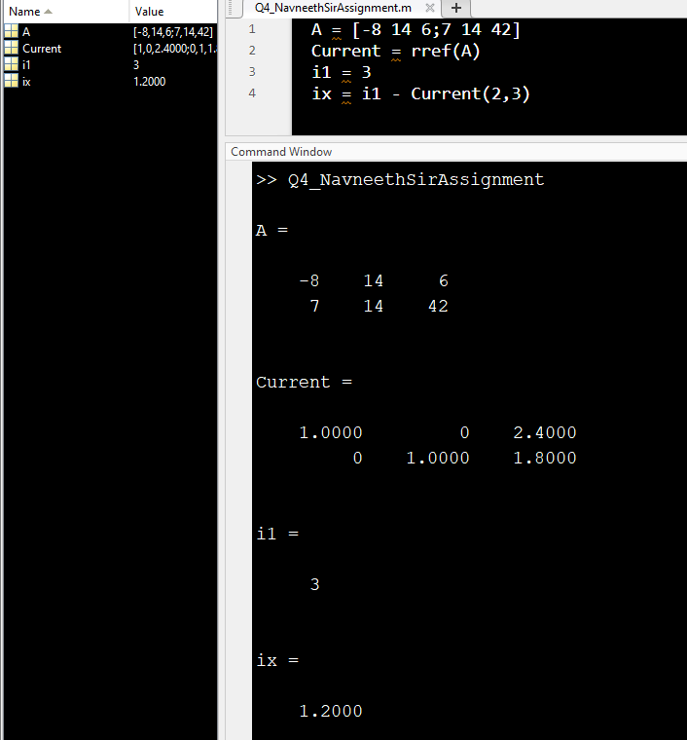
After putting value of i₁ in equation of loop 1 and loop2 we will get following 2 equations,
i₂+2i₃ = 6 → eq(1)
14i₃-8i₂ = 6 →eq(2)
Using above two equations a square matrix can be formed and by the help of that square matrix we can get value of i₂ and i₃ . USING MATLAB MATRIX CAN BE SOLVED and BY HELP OF DIFFERENT COMMANDS
_{1.) Using rref command}
Rref code is
used to form
reduced row
echelon form of
symbolic matrix A

Slide 22
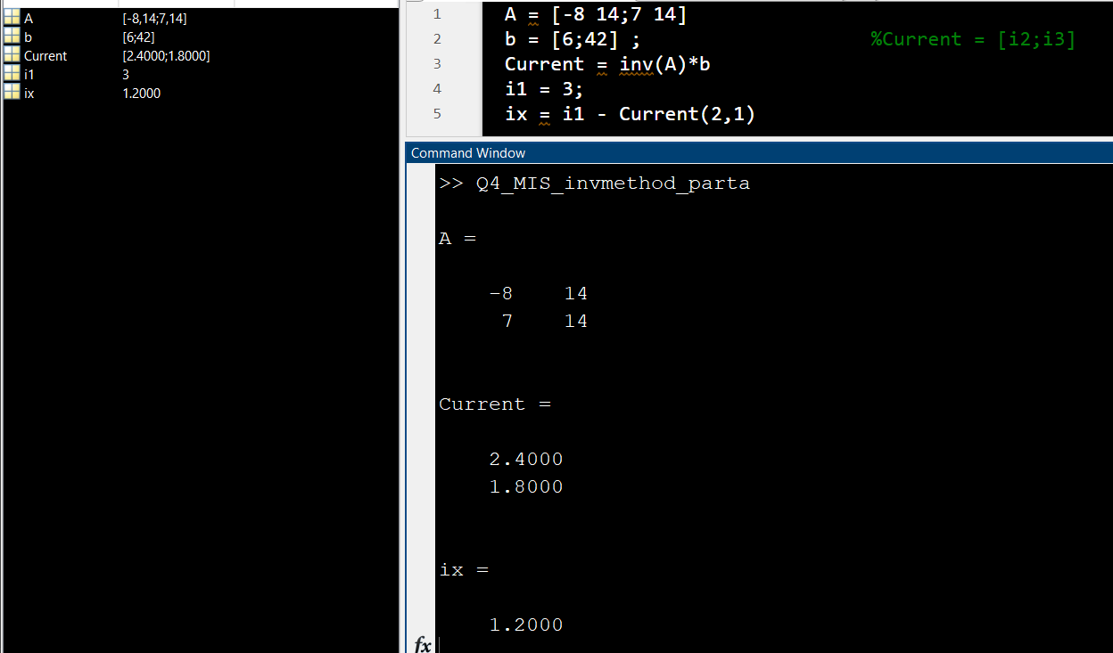
2.) Using inv()

Slide 23
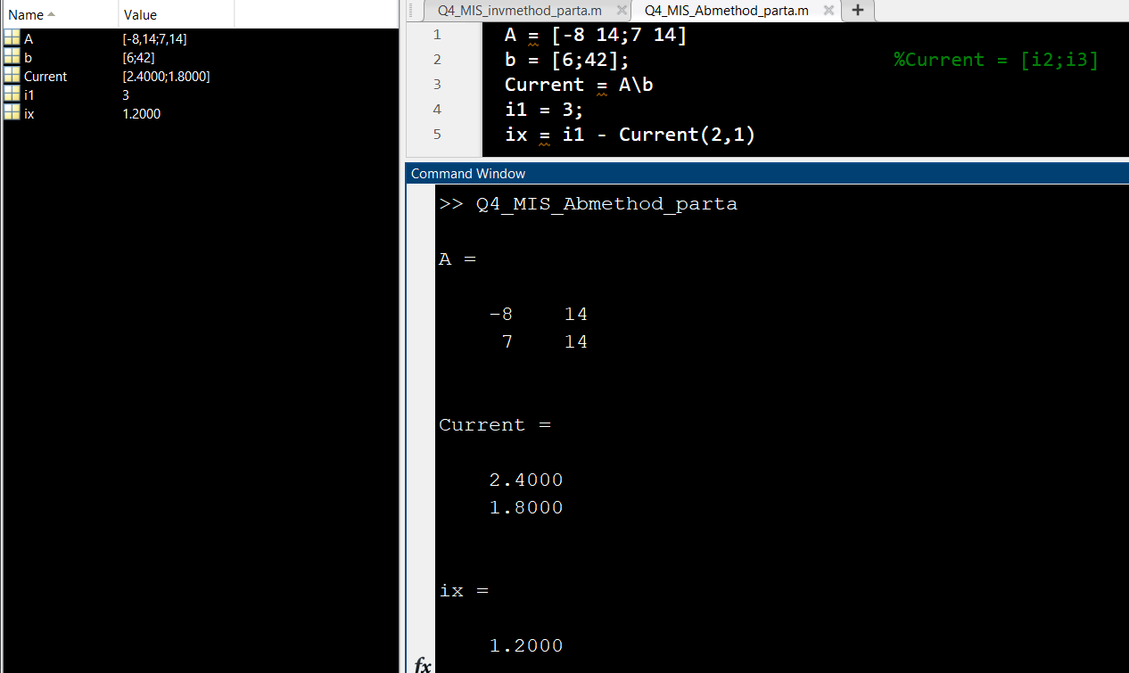
3.) Using x = A\b It solves the system of linear equations A*x=B. The matrices A and B must have same number of rows .

Slide 24
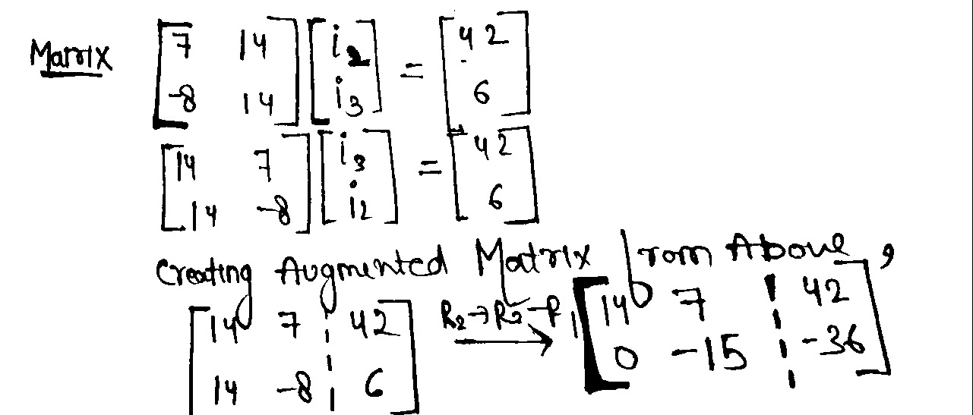
Solve for the current i_{x} using system of Elimination Matrices
Solving using Elimination Matrices
From Equations written below:
i₁ = 3A
i₂ = 2i_{x}
i_{x} = i₁-i₃
14i₃+7i₂ = 42 → eq(1)
14i₃ -8i₂ = 6 → eq(2)
CALCULATION OF GAUSS ELIMINATION MATRIX
Final Matrix we got is an upper triangular matrix achieved from Elimination method to get value of single variable from linear equations.

Slide 25
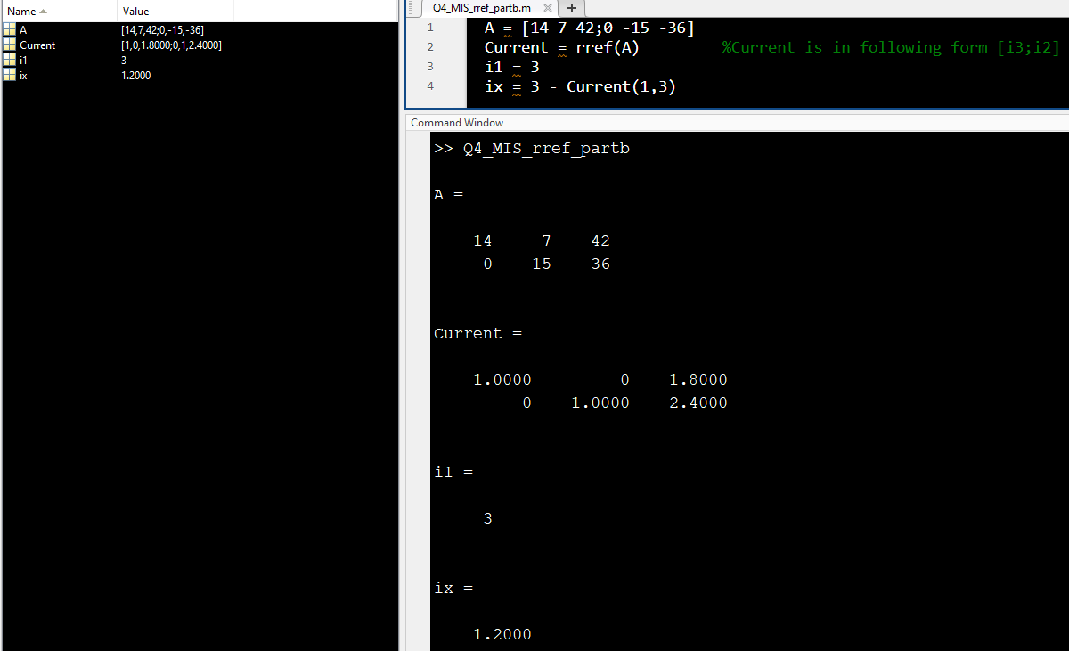
USING MATLAB MATRIX CAN BE SOLVED and BY HELP OF DIFFERENT COMMANDS
_{1.) Using rref command}
Rref code is used to form reduced row echelon form of symbolic matrix A

Slide 26
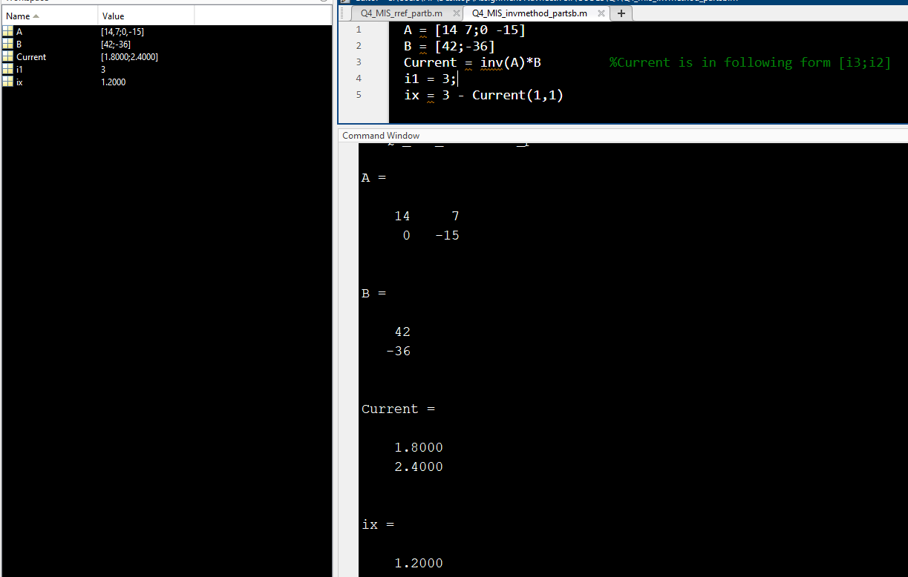
2.) Using inv()

Slide 27
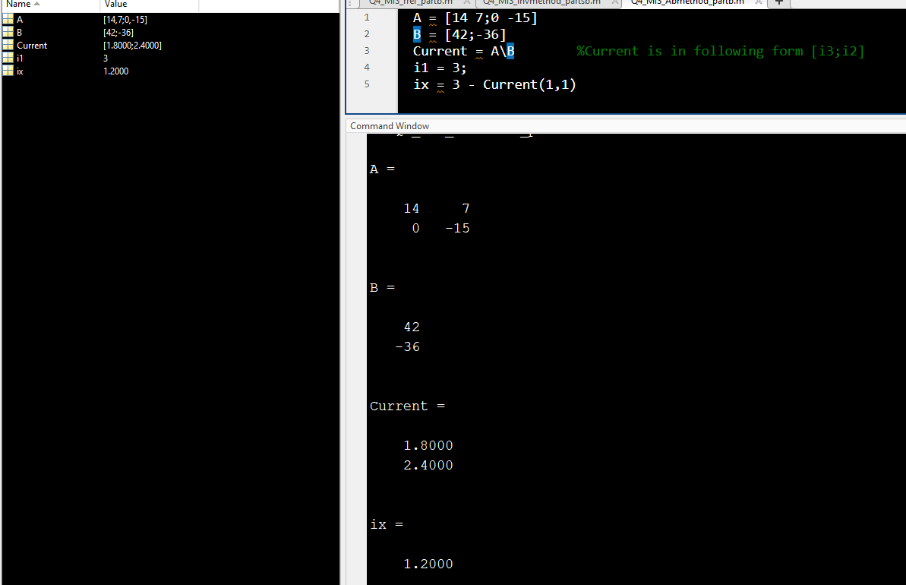
3.) Using x = A\b It solves the system of linear equations A*x=B. The matrices A and B must have same number of rows.
After comparing with all methods we will get the same answer but with different codes and matrices having different rows and columns .

Slide 28
THANK YOU

